Slide 1
NextHikes IT Solutions
Bike Sharing Demand Analysis Project Using Excel
By Mohit Singh

Slide 2
Objectives
To analyze bike rental data to understand user demand patterns across different hours, days, and seasons.
To study the impact of weather conditions, temperature, and time periods on bike rental usage.
To clean and preprocess raw data by removing duplicates, handling missing values, correcting data types, and filtering invalid records.
To merge multiple datasets into a single master dataset for consistent and accurate analysis.
To create derived features such as weekday names, week type (weekday/weekend), time periods, weather categories, and temperature bands.
To apply rolling 24-hour mean and rolling standard deviation to analyze demand trends and variability over time.
To use Z-score analysis to detect unusual rental behavior and identify demand anomalies.
To summarize data using pivot tables, aggregation, and calculated fields for quick insights.
To visualize demand patterns using line charts, bar charts, funnel charts, and heatmaps.
To transform raw data into meaningful insights that support data-driven decision making.
To help improve operational planning, fleet management, and customer experience through analytical insights.

Slide 3
Weekday vs Weekend Bike Rental Usage
The chart compares total bike rentals by weekday vs weekend and shows that overall usage is much higher on weekdays, mainly driven by registered users. Weekends have lower total demand but a relatively higher share of casual users.
Key Highlights :-
Weekdays Dominate Total Usage
Weekday rentals are significantly higher than weekends, indicating strong dependence on daily commuting.
Registered Users Drive Demand
Registered users form the majority of rentals on both weekdays and weekends, especially on weekdays.
Casual Usage Increases on Weekends
Although total volume is lower, casual rentals are slightly higher on weekends than weekdays, suggesting leisure-driven use.
Different Use Patterns by Week Type
Weekdays reflect routine travel (office/work), while weekends show more flexible and recreational usage.

Slide 4
Hour-wise Bike Rental Trends
This chart shows bike rentals by hour of the day. Most rentals come from registered users, with clear peaks in the morning and evening. Casual users rent fewer bikes and mostly during the daytime.
Key Highlights :-
Morning and evening are busiest
Rentals are highest around 8–9 AM and 5–6 PM, mainly because people travel to and from work.
Registered users use bikes the most
Registered users rent many more bikes than casual users at all hours.
Very low use at night
From 12 AM to early morning, bike usage is very low.
Casual users prefer daytime
Casual users mostly rent bikes in the late morning and afternoon, likely for leisure or short trips.

Slide 5
Impact of Weather on Bike Rental Usage
Bike rentals depend strongly on weather conditions. Most users ride bikes when the weather is clear or partly cloudy. Rentals drop sharply during rain and snow, especially for casual users.
Key Highlights :-
Best usage in clear weather :-
Most bike rentals happen when the weather is clear or partly cloudy.
Registered users ride in all weather :-
Registered users continue using bikes even in mist or light rain, unlike casual users.
Very low usage in bad weather :-
Heavy rain and snow show extremely low bike usage.
Casual users are weather-sensitive :-
Casual users mostly ride only in good weather.

Slide 6
Month-wise Bike Rental Distribution
This chart shows monthly bike rentals. January has much higher usage than February, contributing nearly two-thirds of total rentals. This indicates strong seasonality in bike demand.
Key Highlights :-
January is the peak month :-
January accounts for 38,189 rentals (65%), showing very high demand.
February has lower usage :-
February records 20,115 rentals (35%), almost half of January’s usage.
Clear seasonal effect :-
Bike usage changes by month, likely due to weather or seasonal conditions.
Better planning for peak months :-
More bikes and resources should be planned for high-demand months like January.

Slide 7
Average Bike Rentals by Weather Condition
This chart shows the average number of bike rentals under different weather conditions. Bike usage is highest in clear or partly cloudy weather and lowest during snow or rain.
Key Highlights :-
Best average usage in clear weather :-
Clear/Partly Cloudy weather has the highest average rentals.
Mist/cloudy also supports good usage :-
Even with mist or cloudy weather, bike usage remains relatively high.
Rain reduces bike usage :-
Heavy rain significantly lowers average rentals.
Snow or light rain has the lowest usage :-
Light snow/rain shows the lowest average rentals.

Slide 8
Weekday-wise Bike Rental Usage
This chart shows bike rentals by day of the week. Registered users rent bikes much more than casual users on all days. Usage is highest on Friday and lower during mid-week.
Key Highlights :-
Registered users dominate every day :-
Registered rentals are much higher than casual rentals across all weekdays.
Friday has the highest usage :-
Bike rentals peak on Friday, likely due to end-of-week travel.
Mid-week is quieter for casual users :-
Casual rentals are lowest from Tuesday to Thursday.
Weekend casual usage increases :-
Casual rentals rise on Saturday and Sunday, showing leisure usage.

Slide 9
Bike Rentals by Temperature Category
This chart shows bike rentals by temperature category. Mild weather has the highest bike usage, followed by cold weather, while warm weather has the lowest usage. Registered users rent more bikes in all temperature conditions.
Key Highlights :-
Mild weather is best for bike rentals :-
Most rentals happen when the temperature is mild.
Registered users dominate in all temperatures :-
Registered users rent far more bikes than casual users in every temperature category.
Cold weather still has good demand :-
Bike usage remains strong even in cold conditions.
Warm weather shows lower usage :-
Fewer people rent bikes during warm temperatures, possibly due to discomfort.

Slide 10
Bike Rentals by Time Period
This chart shows bike rentals by time period of the day. Registered users rent the most bikes in the evening and morning, while casual users prefer the afternoon. Night-time usage is the lowest for both user types.
Key Highlights :-
Evening and morning are busiest for registered users
Registered rentals are highest during evening and morning, showing daily commute usage.
Casual users prefer afternoon:-
Casual rentals peak in the afternoon, likely for leisure or short trips.
Night has the lowest demand :-Both casual and registered usage drop sharply at night.
Different usage patterns by user type:-
Registered users use bikes for routine travel, while casual users use them for daytime activities.

Slide 11
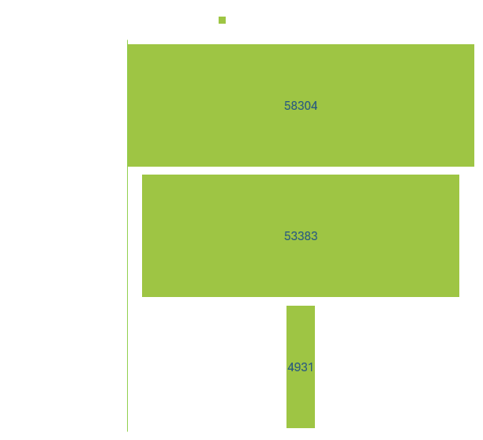
Total Users Breakdown: Registered vs Casual
This chart shows the total number of bike users. Most users are registered users, while casual users make up a very small part of total usage.
Key Highlights :-
Registered users are the majority :-
Out of 58,304 total users, 53,383 are registered, showing strong regular usage.
Casual users are very few :-
Casual users contribute only a small portion of total rentals.
Business depends on registered users :-
Most bike usage comes from repeat and loyal users.
Opportunity to grow casual users ;-
Casual users can be increased through offers, promotions, or tourist plans.

Slide 12
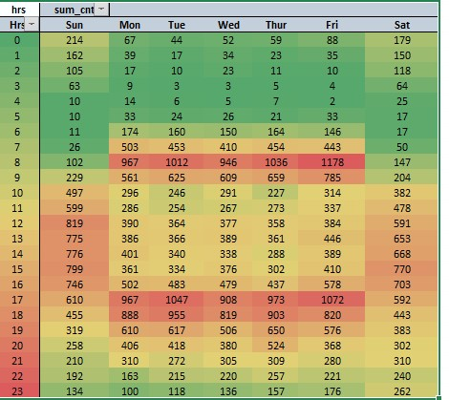
Hourly Bike Rental Pattern by Day of Week
This heatmap shows bike rentals by hour and day of the week. Usage is very low late at night and early morning, rises sharply during office commute hours, and stays higher on weekdays, especially Monday to Friday.
Key Highlights :-
Morning and evening are the busiest times :-
Highest rentals are seen around 8–9 AM and 5–6 PM, mainly on weekdays.
Weekdays have more usage than weekends :-
Monday to Friday show much higher demand compared to Saturday and Sunday.
Late night and early morning are very quiet :-
From 12 AM to 5 AM, bike usage is very low across all days.
Friday shows strong evening demand :-
Friday evening has one of the highest rental counts, indicating end-of-week travel.

Slide 13
Challenges
Handling raw and unclean data, including missing values, duplicates, and incorrect data types.
Merging multiple datasets without losing records or creating inconsistencies.
Managing date and time data correctly, especially hourly data (0–23) across multiple days.
Creating derived columns (time periods, weather categories, temperature bands) accurately.
Accurately calculating rolling 24-hour mean and standard deviation while correctly identifying true anomalies without misclassifying normal demand fluctuations..
Selecting the right visualization to clearly represent hourly and daily demand patterns.
Ensuring pivot tables and calculated fields generate accurate summaries while remaining dynamic and updating correctly with filters and slicers.
Choosing appropriate measures and dimensions while building pivot-based analysis.
Creating an interactive dashboard that balances clarity, insights, and performance.
Aligning multiple charts in a dashboard to tell a consistent analytical story.
Maintaining data consistency while applying filters, slicers, and transformations.
Presenting insights in a simple and understandable way for non-technical stakeholders.

Slide 14
THANK YOU

